Slide 1

: GenevaERS View Builder Training Course : Introduction to Lookups
Notes:
Welcome to the training course on , or GenevaERS. This is : Introduction to Lookups.

Slide 2
Page Objectives
Upon completion of this Page, you should be able to:
Describe a typical GenevaERS lookup path
Create a lookup path in the GenevaERS Workbench
Include join data, using the lookup path in a view
Update and run the GenevaERS Join phase JCL
Interpret the results of join processing
Notes:
This Page provides you with an overview of GenevaERS lookup processing. Upon completion of this Page, you should be able to:
Describe a typical GenevaERS lookup path
Create a lookup path in the GenevaERS Workbench
Include join data, using the lookup path in a view
Update and run the GenevaERS Join phase JCL
Interpret the results of join processing

Slide 3

Lookup
A lookup path is a GenevaERS metadata component defining how to retrieve information from a target logical record (LR) using data from a source LR. It is similar to the SQL “where” clause in a relational database join*.
Source
Target
ORDER
-Order_Id (PK)
-Customer_Id (FK1)
-Store_Id (FK2)
-Order_Date
-Total_Amt
-Rebate_Amt
CUSTOMER
-Customer_Id (PK)
-Gender_Cd (FK2)
-Customer_DOB
-Date_Became_Customer
-Customer_Phone_Num
-Customer_Email_Addr
-Preferred_Contact_Cd (FK1)
GenevaERS
Lookup
Path
The source in this case is the current source file being scanned. The
target is the file that contains the information to be retrieved.
*Specifically, a GenevaERS join is similar to an IBM® DB2® left outer join.
Notes:
Copyright IBM Corp. 2012, licensed under Apache 2.0 to the GenevaERS project Course materials may not be reproduced in whole or in part without the prior written permission of IBM.
GenevaERS allows users to combine or "join" data together from different files for selection tests or inclusion in an output. This requires telling GenevaERS which data from the two files to match, the source, and the target. These files typically have different layouts, described by differing GenevaERS logical records, or LRs. GenevaERS requires these source and target relationships to be predefined in a GenevaERS lookup path. The lookup path is similar to an SQL "where" clause in a relational database.

Slide 4
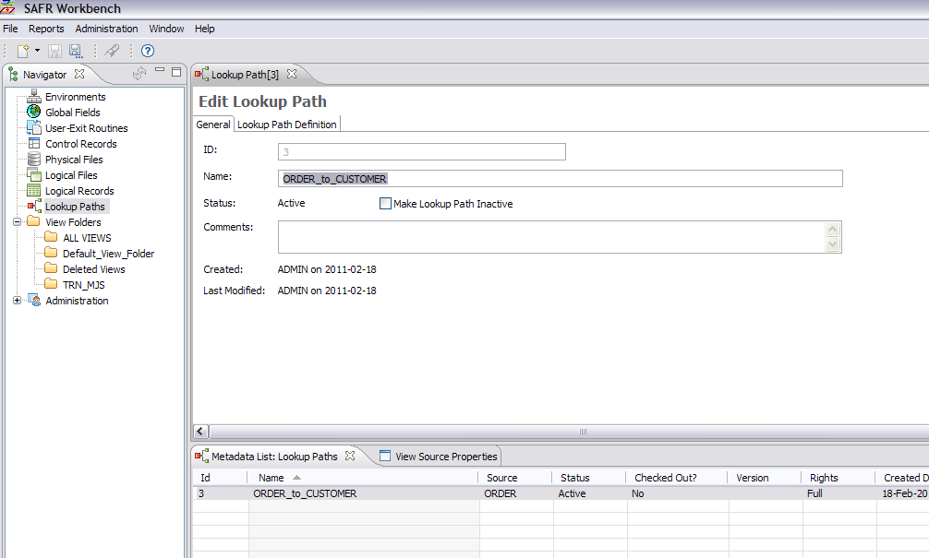
Lookup Path
Notes:
Copyright IBM Corp. 2012, licensed under Apache 2.0 to the GenevaERS project Course materials may not be reproduced in whole or in part without the prior written permission of IBM.
Lookup paths can be used by many different views. To view existing lookup paths, click Lookup Paths in the Navigator pane and open a lookup path in the metadata list at the bottom of the screen.
To create a new lookup path, select Administration, then New, and then Lookup Path from the menu.

Slide 5
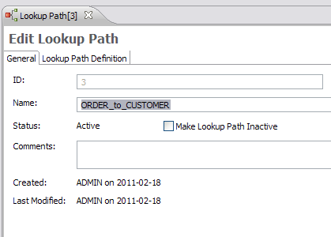
Lookup Path – General Tab (1 of 3)
The General tab is used to enter the lookup path name, enter comments, and change the status of the lookup from active to inactive.
ID – Generated by GenevaERS (not editable)
Notes:
Copyright IBM Corp. 2012, licensed under Apache 2.0 to the GenevaERS project Course materials may not be reproduced in whole or in part without the prior written permission of IBM.
The General tab of the selected lookup path shows the lookup path ID, name, comments, and status, either active or inactive.
When you create a new lookup path, the lookup path ID is assigned by the Workbench and is not editable. It is used to make each lookup path unique and appears along with the lookup path name in views.

Slide 6
Lookup Path – General Tab (2 of 3)
The General tab is used to enter the lookup path name, enter comments, and change the status of the lookup from active to inactive.
ID – Generated by GenevaERS (not editable)
Name – The name given to the lookup path. Typically named using the source and target LRs.
Notes:
Copyright IBM Corp. 2012, licensed under Apache 2.0 to the GenevaERS project Course materials may not be reproduced in whole or in part without the prior written permission of IBM.
The name of the lookup path is visible when you are using it in views. When you name a lookup path, it is good practice to include the source-LR-to-target-LR mapping performed by the path. Also, if more than one lookup path in your environment is used to join the same source LR and target, you should add additional qualifiers to the name to provide uniqueness.

Slide 7

Lookup Path – General Tab (3 of 3)
The General tab is used to enter the lookup path name, enter comments, and change the status of the lookup from active to inactive.
ID – Generated by GenevaERS (not editable)
Name – The name given to the lookup path. Typically named using the source and target LRs
Status – Current status of the lookup path. A single left-click in the Make Lookup Path Inactive check box deactivates the lookup path.
Notes:
Copyright IBM Corp. 2012, licensed under Apache 2.0 to the GenevaERS project Course materials may not be reproduced in whole or in part without the prior written permission of IBM.
Lookup paths are created with an Inactive status and remain inactive until they are completely defined. They can then be activated, allowing for use in views.
If an active lookup path changes, all views referencing that lookup path are deactivated to prevent views from performing inaccurate joins. Select the Make Lookup Path Inactive check box to deactivate the lookup; this also deactivates all the views using the lookup path.

Slide 8
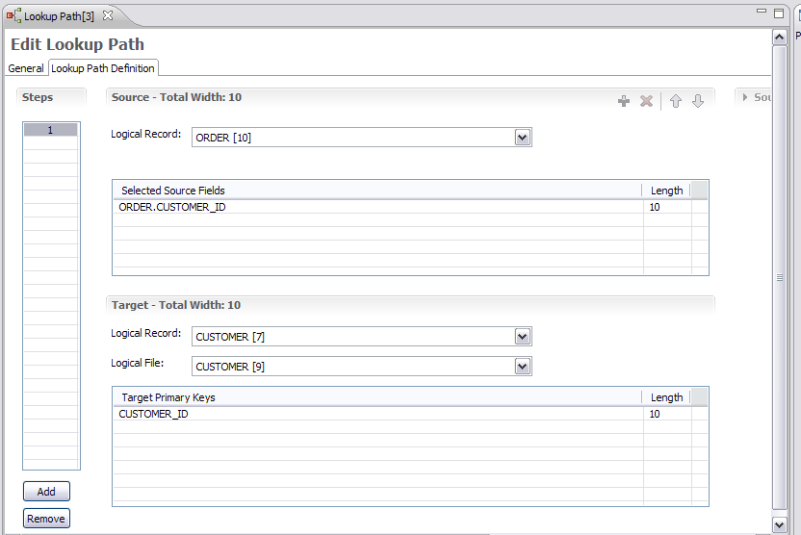
Lookup Path – Lookup Path Definition Tab
The lookup path definition defines which source fields should be matched to the target primary keys in the join.
Notes:
Copyright IBM Corp. 2012, licensed under Apache 2.0 to the GenevaERS project Course materials may not be reproduced in whole or in part without the prior written permission of IBM.
From the General tab, we’ve clicked the Lookup Path Definition tab, where we can select the source logical record and the target LR and its specific logical file. We can then select the source fields that should be used to create a key to search the target to find a matching record. The accumulated length of the source fields must equal the total key length before the lookup path can be activated and used for processing in a view.

Slide 9
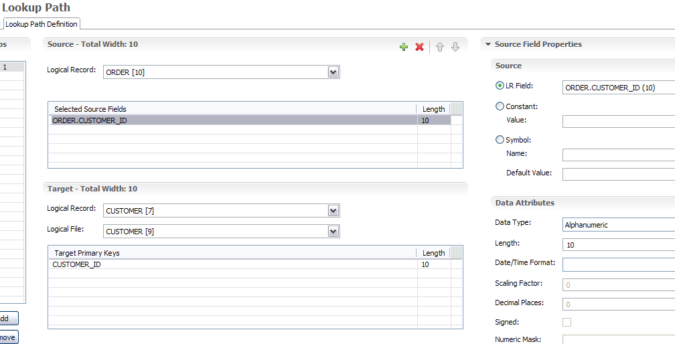

Lookup Path – Lookup Path Constant Values
You use the Source Field Properties screen to select a field from a logical record, specify a static or dynamic (symbolic) constant, and specify the field length and format.
Constant and symbolic values can be assigned using the radio buttons in the Source Field Properties area.
Notes:
Copyright IBM Corp. 2012, licensed under Apache 2.0 to the GenevaERS project Course materials may not be reproduced in whole or in part without the prior written permission of IBM.
The Source Field Properties area is displayed when the Selected Source Fields list is clicked. Here you can select a source field from the source logical record or specify a constant that should be used in the key. Constants can be either static, as shown here, or symbolic, which allows setting the value in the view when the lookup path is used. When specifying a constant, carefully consider the format of the target key when setting the format (data type), length, and so on.
We’ve now completed the lookup path. Next, we’ll see how to use it in the view.

Slide 10
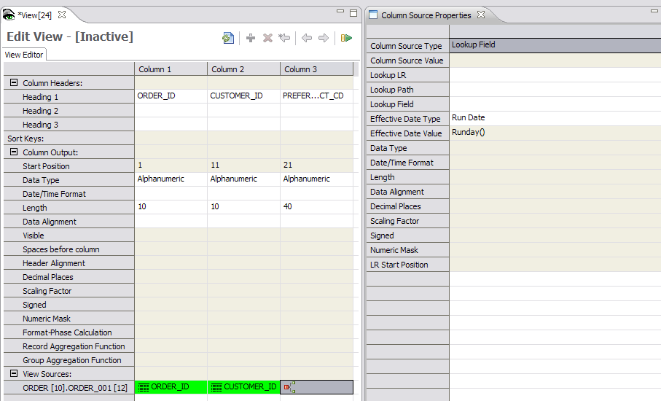
Lookup – Column Source Properties
Notes:
IBM Security AppScan Source V8.6 Fundamentals
Copyright IBM Corp. 2012, licensed under Apache 2.0 to the GenevaERS project Course materials may not be reproduced in whole or in part without the prior written permission of IBM.
On this slide, we’ve switched to the View Editor, creating a view that reads a file that is described by the Order LR. In column 3, we require a field that is on the Customer LR. After inserting the column, we select Lookup Field as the source for the column.

Slide 11
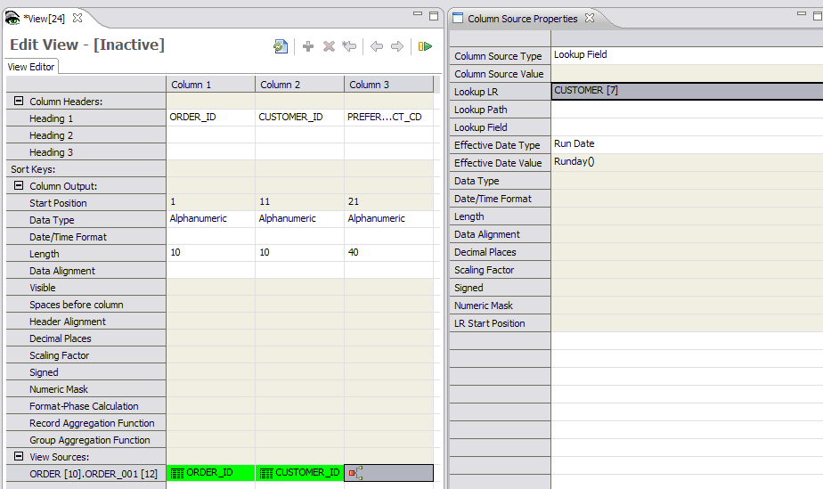
Lookup – Specify LR
Notes:
IBM Security AppScan Source V8.6 Fundamentals
Copyright IBM Corp. 2012, licensed under Apache 2.0 to the GenevaERS project Course materials may not be reproduced in whole or in part without the prior written permission of IBM.
Next, the Lookup LR box lists all the LRs that can be accessed from the order LR, based upon the lookup paths that have been created. Because we created the Order to Customer lookup path, the Customer LR is available in the list.

Slide 12
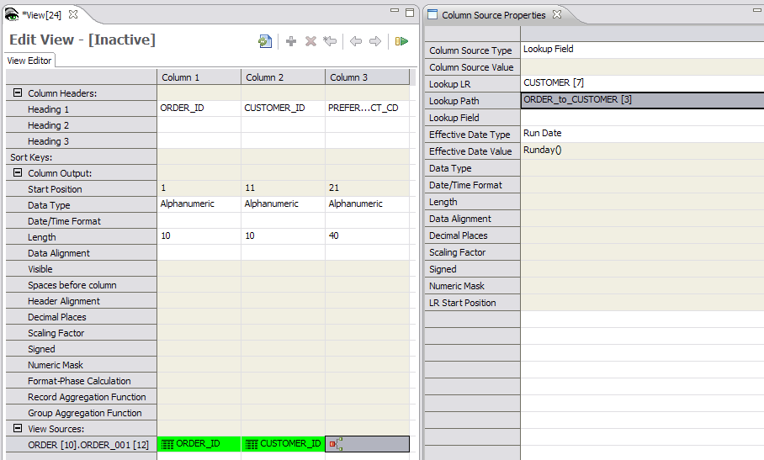
Lookup – Selecting the Lookup Path
Notes:
IBM Security AppScan Source V8.6 Fundamentals
Copyright IBM Corp. 2012, licensed under Apache 2.0 to the GenevaERS project Course materials may not be reproduced in whole or in part without the prior written permission of IBM.
Next, we select the lookup path that we want to use to perform the join. This is necessary because multiple methods of joining from one LR to another might exist. For example, the Order LR might have a Purchasing Customer ID field and a Ship to Customer ID field, and either of these might be used as the basis for a different lookup path to find the customer address. In this instance, we’ve selected the lookup path that we have just created, with a lookup ID of 3.

Slide 13
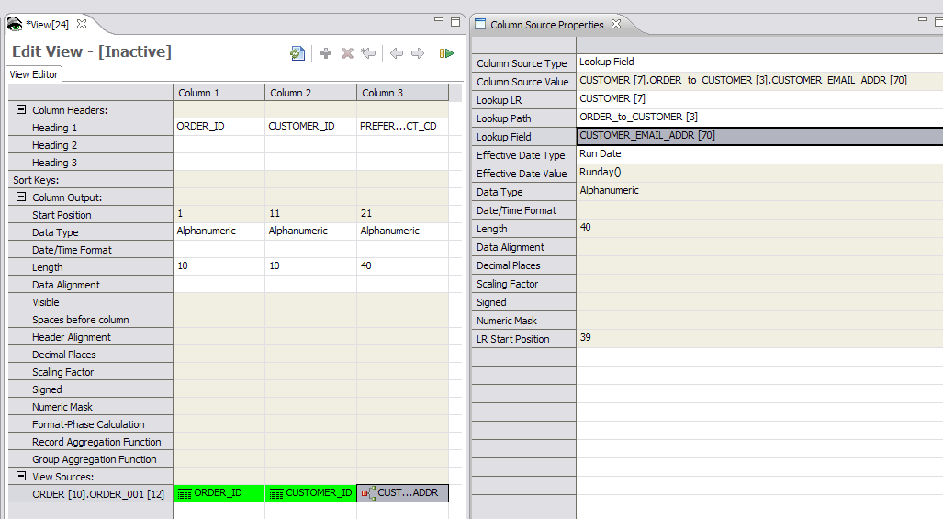
Lookup – Selecting the Output Field
Notes:
IBM Security AppScan Source V8.6 Fundamentals
Copyright IBM Corp. 2012, licensed under Apache 2.0 to the GenevaERS project Course materials may not be reproduced in whole or in part without the prior written permission of IBM.
Finally, we select the actual field we want to place on the extract file. All the fields on the Customer LR are available for use. In this instance we’ve selected the customer email address to be put out on the extract file.
Note that the Column Source Value field is populated with Customer[7].Order_to_Customer[3].Customer_Email_Address[70]. This is the LR, path, field names, and IDs. This pattern is used in numerous places in the Workbench.

Slide 14
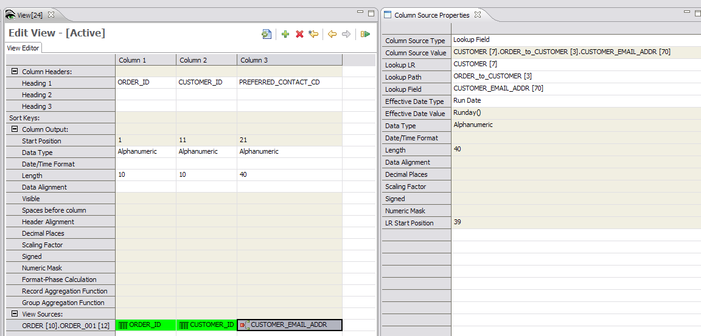
View Columns
Notes:
Copyright IBM Corp. 2012, licensed under Apache 2.0 to the GenevaERS project Course materials may not be reproduced in whole or in part without the prior written permission of IBM.
We've used the lookup path in the view, resulting in a join. Looked-up fields can be placed in output columns, used as sort and aggregation fields, or used in filtering processes or calculations using similar steps.
We’ve now completed the view. Next, we’ll see how to run it in the Performance Engine.

Slide 15

Select Phase Data Flow
View List
GenevaERS
Metadata
Repository
GVBMR86
Specifying the View Number
XML
MR86RPT
Notes:
Recall from prior pages that the first step in running the Performance Engine is running MR86, which takes in the View List and the GenevaERS Metadata Repository and creates an XML file of the view.

Slide 16
COMPILE Phase Data Flow
XML
GVBMR84
MR84
VDP
MR84RPT
Notes:
The next program is GVBMR84, the COMPILE, which produces the MR84 VDP. The addition of join processing makes no significant changes to this process.

Slide 17
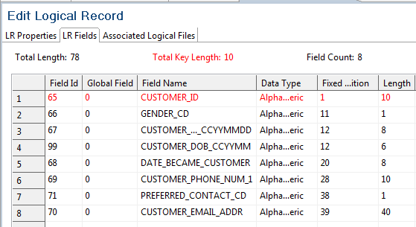
Logic Phase Data Flow
MR84
VDP
GVBMR90
Join Fields Required in Extract Processing
- Customer ID (10-byte key)
- Customer Email Address
MR90
VDP
MR90
JLT
MR90
XLT
MR90RPT
Notes:
Next, MR90 is run. Because our view requires a lookup, two logic tables are produced. The Extract Logic Table (XLT) is used in the actual Extract phase as the view scans the Order file and performs joins to the Customer LR. The Join Logic Table, or JLT, on the other hand, simply prepares the Customer lookup file for use in the Extract phase.
The VDP tells MR90 that only the customer email address, the customer ID, and the join key are required for extract processing. The Join phase will use the JLT to extract only these two fields to be loaded into memory during the Extract phase processing to perform the joins.

Slide 18

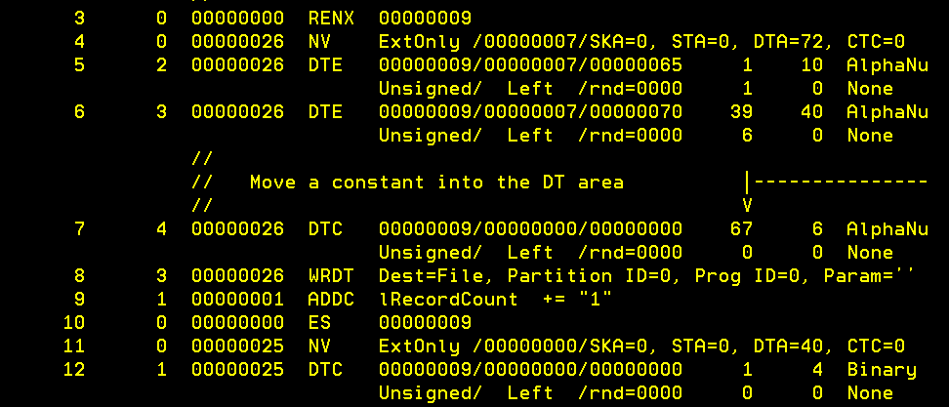
Reviewing the MR90 Report - Success
JLT view numbers are artificially generated at run time.
Notes:
Copyright IBM Corp. 2012, licensed under Apache 2.0 to the GenevaERS project Course materials may not be reproduced in whole or in part without the prior written permission of IBM.
The MR90 Control Report in the “Performance Engine Overview” module showed an empty JLT when no joins were performed in the view. Now the MR90 Control Report shows the JLT statistics and a printed version of the logic table.
Note that the view numbers listed in the JLT are run-time-only views for this execution of the Performance Engine. These example JLT views, 25 and 26, are never stored in the GenevaERS Metadata Repository

Slide 19
Join Phase Data Flow
MR76
JLT
MR77
VDP
Join
Data
GVBMR95
REH
MR95RPT
RED
Notes:
GVBMR95 produces two files in the Join phase. The RED file contains one row for every row in the input join file (in this example, the customer file), but only the fields required for extract processing. The REH file contains a single control record for each join file.
The following slides detail how to locate the DD name for the input join files for the Join phase GVBMR95 step and modify the JCL.

Slide 20
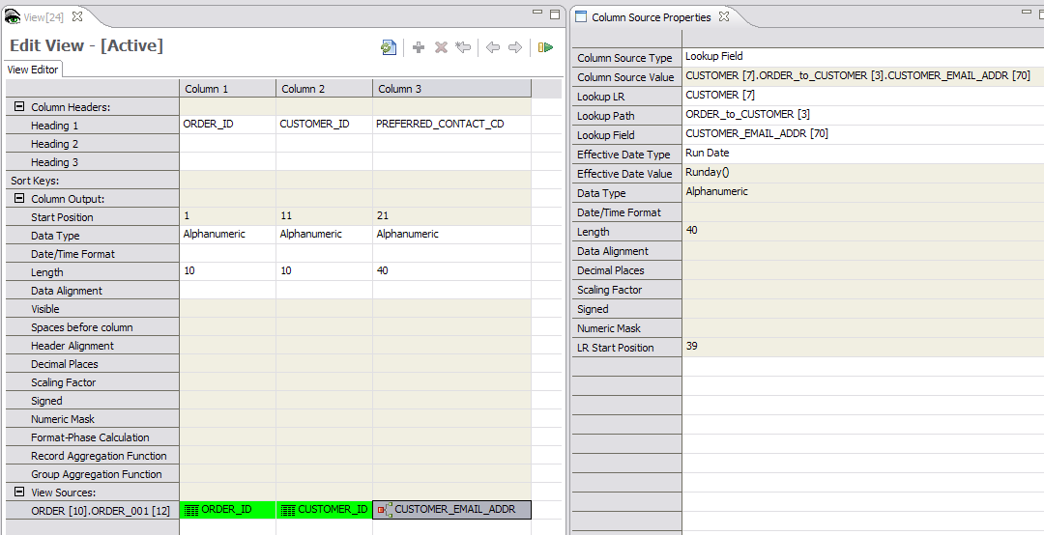
Finding the Lookup Path
=
Join icon; column contains a join.
Notes:
IBM Security AppScan Source V8.6 Fundamentals
Copyright IBM Corp. 2012, licensed under Apache 2.0 to the GenevaERS project Course materials may not be reproduced in whole or in part without the prior written permission of IBM.
First, within the view, locate the lookup path used for any joins. For this example view, we are using the Order to Customer lookup path ID 3. The path name is highlighted on the slide.
Columns containing a joined field are highlighted with a Join icon to speed identification of required joins.

Slide 21
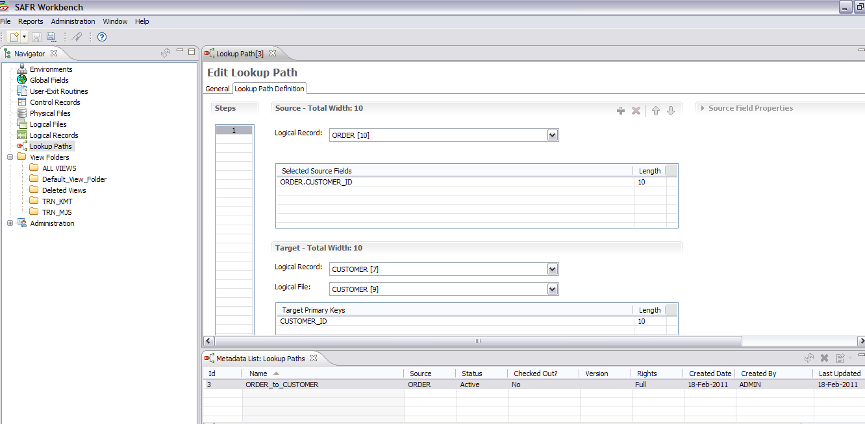
Finding the Logical File of the Join Data
3 – Click the Lookup Path Definition tab.
4- Find the target
logical file on
the lookup path.
1 - Select Lookup Paths.
2 – Click the lookup path.
Notes:
IBM Security AppScan Source V8.6 Fundamentals
Copyright IBM Corp. 2012, licensed under Apache 2.0 to the GenevaERS project Course materials may not be reproduced in whole or in part without the prior written permission of IBM.
Next, click the Lookup Path icon in the Navigator pane. A list of all paths is shown at the bottom of the screen.
Select the path from the list. The Edit Lookup Path screen opens.
Click the Lookup Path Definition tab.
Note the target logical file defined for the lookup path. This value is used in the next step.

Slide 22
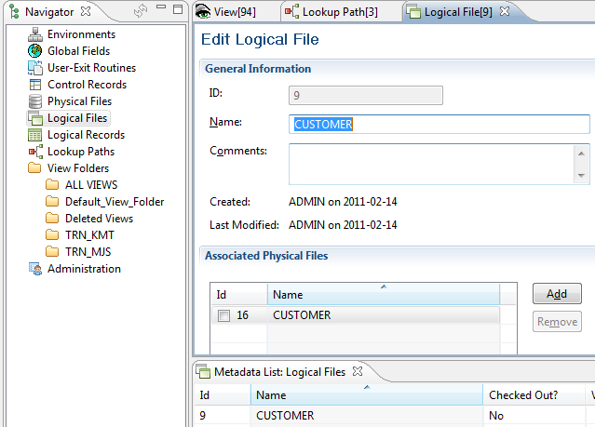
Join File DD Names
2 – Find the
physical
file.
1 – View the
logical files.
Notes:
Next, locate the logical file by performing the following steps.
First, select Logical Files in the Navigator pane and then select the appropriate logical file from the list of logical records.
Next, find the associated physical file. The DD name is listed in the physical file definition, which we’ll find next.
Note that join files can be associated with only one physical file.

Slide 23
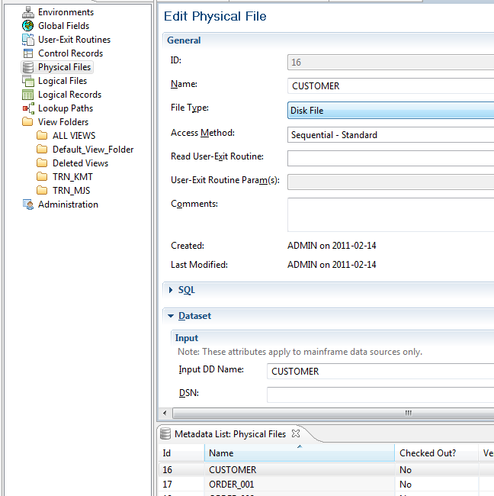

Specifying the Join Source Files in the JCL
Final steps to locate the DD name:
2 – Find
the input
DD name.
1 - Find
the physical
file.
Notes:
Next, click the Physical File icon and select the specific file from the Associated Physical Files list.
Last, locate the input DD name.
This DD name should be placed in the join file job for use by GVBMR95, as shown at the bottom of this slide. The DD name must point to the file containing customer data. Note that join files must be in sorted order by the key specified in the logical record. An error is issued in the Extract phase if the files are not in sorted order

Slide 24
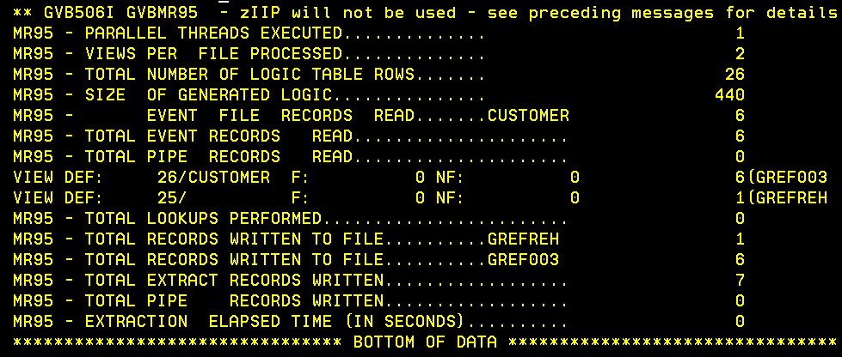
Reviewing the Join Phase MR95 Report
Notes:
After execution of the MR95 in the Join phase job, the MR95 Control Report shows the number of records read from the input Customer join file. It also shows how many records were written to the RED file (DD name GREF003) and the REH file (DD Name GREFREH). These files are then used in the Extract phase.

Slide 25
Extract Phase Data Flow
MR76
XLT
MR77
VDP
Source
Data
REH
RED
GVBMR95
MR95RPT
View
Output
Extract
Work
Files
Notes:
Following the Join phase execution of MR95, the Extract phase is run. Its inputs include the XLT, the REH and RED files, and the source or event file data (in this example, the Order file).

Slide 26
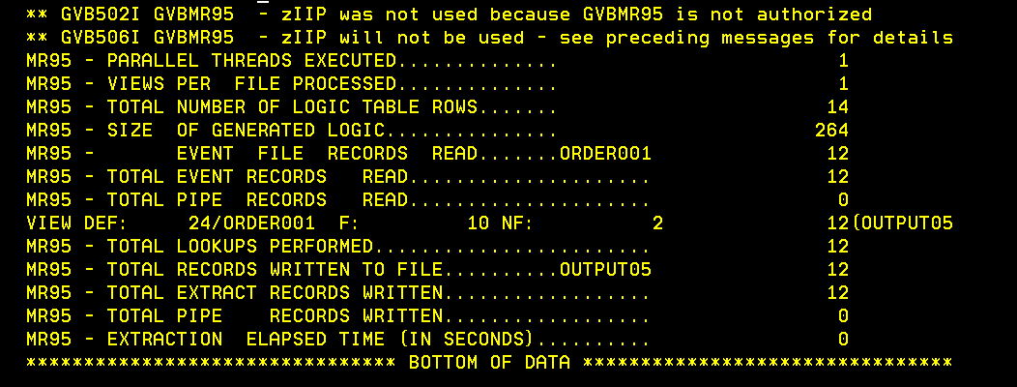
Reviewing the EXTRACT MR95 Report - Success
Lookup
Information
Notes:
The Extract phase MR95 Control Report shows the processing of view 24 reading the Order file. Note that, on the same row showing how many records were extracted from the Order file (12), the control report also shows 10 lookups found (designated by the letter “F”) and 2 lookups not found (NF). This means two orders were associated with at least one customer ID on the Order file, which did not have corresponding customer records in the Customer file.
The report also shows that a total of 12 lookups were performed.

Slide 27
Module Summary
Now that you have completed this module, you should be able to:
Describe a typical GenevaERS lookup path
Create a lookup path in the GenevaERS Workbench
Include join data, using the lookup path in a view
Update and run the GenevaERS Join phase JCL
Interpret the results of join processing
Notes:
Copyright IBM Corp. 2012, licensed under Apache 2.0 to the GenevaERS project Course materials may not be reproduced in whole or in part without the prior written permission of IBM.
This module provided an introduction to lookups. Now that you have completed this module, you should be able to:
Describe a typical GenevaERS lookup path
Create a lookup path in the GenevaERS Workbench
Include join data, using the lookup path in a view
Update and run the GenevaERS Join phase JCL
Interpret the results of join processing

Slide 28

For Additional Information
The following table provides additional support and/or reference material for GenevaERS.
Page Title | Web Address
GenevaERS Information Center | http://GenevaERS.ibm.com/help/index.jsp
GenevaERS Solution Page | http://www.ibm.com/systems/GenevaERS
Exploiting IBM GenevaERS to Solve Financial Accounting Challenges | http://www.redbooks.ibm.com/ abstracts/redp4599.html?Open
Notes:
Copyright IBM Corp. 2012, licensed under Apache 2.0 to the GenevaERS project Course materials may not be reproduced in whole or in part without the prior written permission of IBM.
Additional information about GenevaERS is available at the web addresses shown here.

Slide 29
Trademarks
IBM, the IBM logo, and ibm.com are trademarks or registered trademarks of International Business Machines Corporation in the United States, other countries, or both. If these and other IBM trademarked terms are marked on their first occurrence in this information with a trademark symbol (® or ™), these symbols indicate U.S. registered or common law trademarks owned by IBM at the time this information was published. Such trademarks may also be registered or common law trademarks in other countries. A current list of IBM trademarks is available on the web at http://www.ibm.com/legal/copytrade.shtml.
Other company, product, or service names may be trademarks or service marks of others.
Notes:
This page does not have audio.

Slide 30

Thank You
Notes:
This concludes the . Thank you for your participation.

